Slide 1



Assembling & Disassembling of Laptop, Installation of OS
CSP-155

Slide 2

WHAT WE WILL COVER ?
1. WHAT IS LAPTOP?
2. ASSEMBLING & DISASSEMBLING OG LAPTOP
3. WHAT IS OS?
4. OPERATING SYSTEM INSTALLATION

Slide 3


WHAT IS LAPTOP ?
high-end laptops often perform better than low or even mid-range desktop systems
Laptop computers, also known as notebooks, are portable computers that you can take with you and use in different environments. They include a screen, keyboard, and a trackpad or trackball, which serves as the mouse.
Most laptops also include several I/O ports, such as USB ports, that allow standard keyboards and mice to be used with the laptop. Modern laptops often include a wireless networking adapter as well, allowing users to access the Internet without requiring any wires.

Slide 4
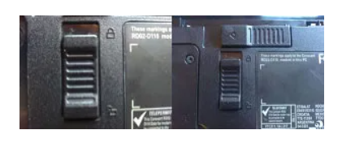
DISASSEMBLING LAPTOP
Removing the battery and power adapter
Move the locking slider to the ‘unlock’ position
Move the other slider in the direction of the arrow
Pull the battery out straight and not on an angle

Slide 5
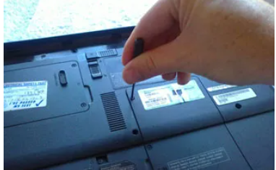
DISASSEMBLING LAPTOP
Remove accessible components
Use an appropriate magnet tipped screwdriver, most of the time you will use a Philips screwdriver for this (see laptop disassembly tools)
2. If you are removing a cover, e.g. a Hard Drive or RAM cover, it may help if you place masking tape over the screw hole to keep the screws in place once the cover is removed so as not to lose the screws.
3. If the screw spins and does not come out first of all turn the laptop over and gently tap the underside, try using the magnetic tip of the screwdriver to pull the screw out if this helps. If the threads on the screw have became worn then consider using a Dremel tool to drill the screw out

Slide 6
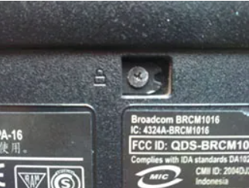
DISASSEMBLING LAPTOP
How to take the back / bottom of a laptop off
Undo the screws from all of the covers that house the components found on the underside of the laptop.
2. The number of covers will vary from laptop to laptop. For neatness and efficiency put the screws back into their holes on the covers once removed from the laptop and consider putting some masking tape over the hole.
3. There is also a single screw that retains the CD/DVD drive. On most laptops this appears as a small CD picture, in this case it is the picture of a padlock. Sometimes this screw is located underneath a cover.

Slide 7
DISASSEMBLING LAPTOP
HARD DRIVE: – Remove this by pulling it in the opposite direction to its data pins. There may be screws or maybe not. The drive should pull out easily. Place it on top of its cover in the cleared area of your desk.
RAM: – There are clips either side of the sticks of RAM that push outward. It is advisable to use a plastic spudger tool whenever possible to prevent any static discharge from occurring. When release the RAM will pop up at an angle of 30 degrees. Remove both sticks of RAM and place them on top of their cover in the cleared area of your desk.
WIRELESS CARD: – There is a small gold tipped cover which you can prise off with minimum effort. This is the wireless antennae. The wireless card itself can be removed in the same manner as the sticks of RAM. Remember to remove it at 30 degree angle.
For now if you see a heat sink under a cover then leave it in place. If you remove it you could damage the CPU.

Slide 8
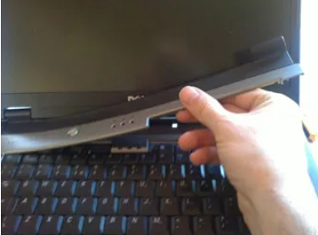
DISASSEMBLING LAPTOP
Remove the ‘Hinge Cover Plate’ and keyboard
With some laptops there are additional screws that retain the Hinge Cover Plate, (HCP) most of the time they will be indicated by a small picture of a keyboard (but not always). These screws will sometimes located inside the removed battery area. Remove them and take a note of their position and type so you can differentiate them from other screws later on.

Slide 9
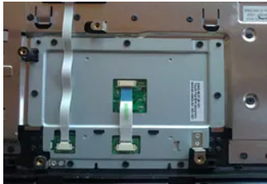
DISASSEMBLING LAPTOP
Remove any other cable under keyboard that you use
It may be a good idea to take a picture or draw a diagram of where all the cables go.
The ribbon cable connectors only come in a few varieties and they either prise forward or upward. You might also see small plastic plugs for some cables. They just pull out.

Slide 10
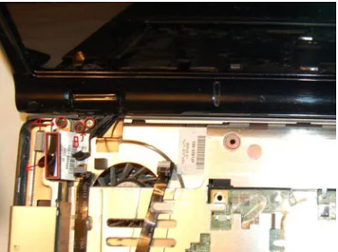
DISASSEMBLING LAPTOP
Remove the Display Unit
Our next step will be to remove the display unit. As with most laptops before this can be done we also need to remove the antennae cable and the LCD data cable. These cables can be connected in variety of manner but removal is usually straight forward.

Slide 11
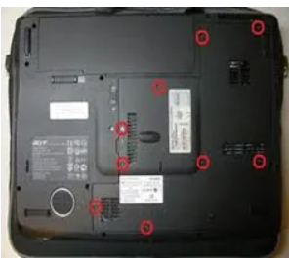
DISASSEMBLING LAPTOP
Continue to remove any other screws from the case
Remove them all and place them either in pile so you can identify them later or into a small container. Make sure you label them so you know where they came from later on.
Repeat this procedure for the other half of the laptop.

Slide 12
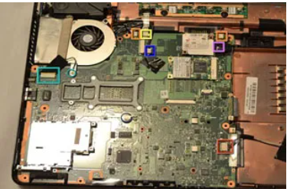
DISASSEMBLING LAPTOP
Pry case apart
Pry case apart – use spudger, fingernails or plastic tools. Again, if you feel resistance STOP and double check you have removed all of the screws.
Remove the motherboard and motherboard peripherals
Take note that the touchpad comes as part of an assembly and when you buy a replacement one of these it comes as the assembly and not just the touchpad.
Slowly take the motherboard out and feel for where the pressure seems to keep the board in place. It should come out with no pressure.

Slide 13
1. Put the motherboard back into the case and reconnect the sound cable.
Put all screws back into the white arrow holes.
Put the case parts back together.
2. Put the retaining screws back into the bottom half of the laptop. Then put the top screws back in.
3. Put the screen back in place and reconnect the antennae and the data cable.
Replace the display hinge screws.
4. Replace the keyboard. First of all put the ribbon cable back in. Remember there is a plastic hinge which holds the ribbon in place, remember to lift this up first (gently).
The ribbon has a darker side and a lighter side. It is the lighter side that faces upward, so there is no twist in the ribbon. Replace the keyboard retaining screws.
5. Click the Hinge Cover Plate (HCP) back into place. Use even pressure to ensure it fits properly.
6. Replace the RAM. Remember it is fed into the slots at 30 degree angles and not straight on. Once it has been fed at a 30 degree angle, click it downwards into place.
7. Finally, replace the component covers and replace all of the screws.
ASSEMBLING LAPTOP

Slide 14


BOOKS YOU CAN REFER
Build Your Own PC Do-It-Yourself For Dummies - Mark L. Chambers
Windows 10 Made Easy: Take Control of Your PC
Book by - James Bernstein
Laptops For Dummies
Book by - Dan Gookin
Troubleshooting And Maintaining Your PC All-in-One Desk Reference for Dummies
Book by - Dan Gookin

Slide 15
Prepared By : Samiksha Sharma Assistant Professor(CSE)
THANKS !

